Slide 1
High Voltage Engineering (E 1530)
Dr/Tarek Abd-Elhamid Dakrory

Slide 2
Generation of HV (DC, AC, and impulse voltage)
The voltage-multiplier circuit using the Cockcroft-Walton.
Used to get HVDC
The voltage doubler circuit is repeated n times

Slide 4
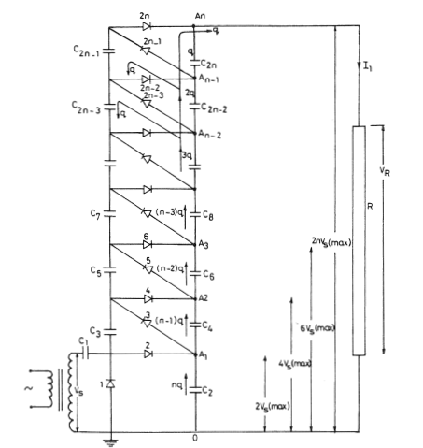

Slide 5
Ripples in Voltage multiplier
ᵟ
ᵟ
ᵟ
If all capacitors are equals = c

Slide 6
Voltage drop in voltage multiplier
In addition to the ripple voltage δ V, there is a voltage drop ∆V which is the difference between the theoretical no-load and on-load voltages.
capacitor C2 loses nq during each cycle, so capacitor C1, has to replenish it.
Therefore, C1 and C2 charge up to [ Vs(max)- nq/C]

Slide 7
Voltage drop
∆
For n › 5, the second and third terms can be neglected
To get the optimum number of stages
The peak value of load voltage I case of nop is
(4/3) Vmax nop

Slide 8
Capacitor values
For ripple voltage the value of lower capacitors can be chosen such that
C1=C2=nC
C3=C4=Cn-1
δ

Slide 9
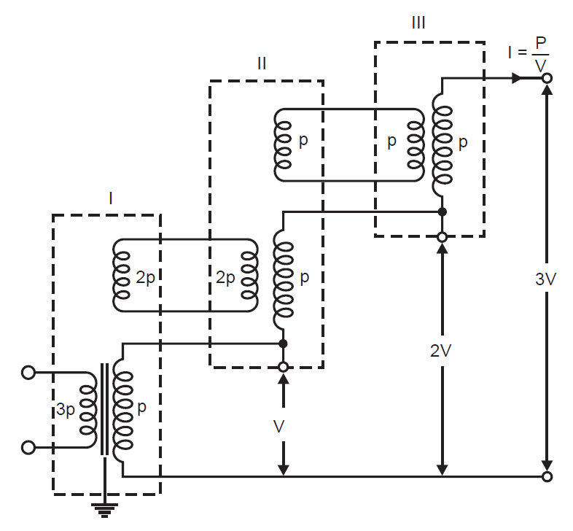
HVAC Generation
Cascaded transformers

Slide 10
Cascaded transformers
Cascaded transformers were first used by Petersen, Dessauer, and Welter (Kind, 1978).
The low-voltage winding(L) of each upper stage is fed from an excitation winding (E) in the stage immediately below it.
The L and E windings are therefore rated at currents higher than those of the H windings; the excitation windings at the lower stages evidently carry higher loading than those of the upper stage E.
If the power carried by the third stage is P,the power carried by the second and first stages are, respectively, 2P and 3P

Slide 11
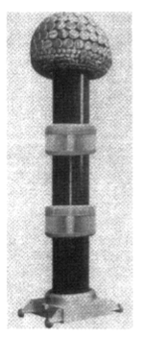
1200kV cascaded transformer with insulating containers. Total height about 12m.

Slide 12
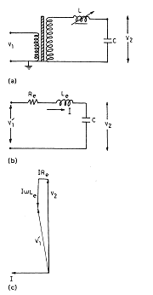
Resonant Circuits.

Slide 13
series resonant transformers
The main advantages of series resonant transformers are: 1. Pure sinusoidal output waveforms. 2. Less power requirements from the mains (5-10% of straight circuit requirements). 3. No high-power arcing or heavy current surges occur if the test object fails, as the resonance is heavily disturbed by the resulting short circuit. 4. Cascading is also possible for producing very high voltages.
5. Simple and compact test setup.
The main disadvantage is that the additional variable reactors should withstand the full-test voltage and full-current rating. Series resonance sets are usually brought into resonance by mechanical adjustment of an air gap in the iron core of the reactor. These sets are designed and commonly used for partial discharge testing and for testing installed gas-insulated systems in the field.

Slide 14
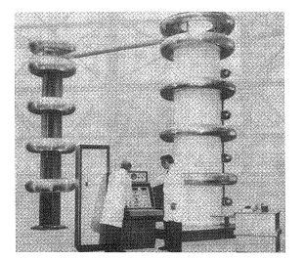
Series resonance
800 kV/8000kVA series-resonant test system.

